Slide 1

AGENDA

Slide 2
INTRODUCTION
DNA sequencing explores the sequence of the four different chemicals which are commonly called as bases. These bases combined together to form a DNA molecule. It’s a nucleotide made of four kinds of nitrogen bases Thymine(T), Adenine(A), Cytosine(C), Guanine(G) in a strand of DNA.
The classification of DNA is a complex task because the medical predictors are not uniformly classified.
Machine learning model (ML) has an advantage over manual examining as it reduces lot of time spent by the technicians and physicians to conclude whether which gene family the person belongs too.

Slide 3
OBJECTIVE
The main objective of this study is to develop a machine learning (ML)-based system for classifying DNA.
To design a model by using Nature Inspired Algorithms (NIA) to enhance the performance of classifiers
Comparison of different classifiers’ performance by using different techniques along with NIA.

Slide 4
ABSTRACT
A significant variety of nature-inspired techniques are used in the field of Machine Learning (ML) to handle a wide range of problems.
The motive of this study is to design a model which used to classify DNA sequence in patients with improved accuracy.
The evaluation of model is carried with the help of human data set from Kaggle.
This work implants the usage of nature inspired optimization technique, randomized search cv and base model evaluation for classifying DNA sequence. The nature inspired algorithms such as bat algorithm, hybrid bat algorithm, grey wolf optimization algorithm and firefly algorithm were used in this work.
In this work the majority classifiers’ performance were enhanced with the help of nature inspired algorithm.

Slide 5

Existing Vs Proposed
Approaches and techniques are minimal
Few classification algorithms are been implemented
Further improvement in the models have not been done
Mainly focused on accuracy as the performance metrics
6 classification algorithms has been done
Further improvement in the models has been done with hyper parameter tuning and NIA
7 performances metrics has been implemented for all the classifiers’

Slide 6
METHODOLOGY
Collection and exploration of dataset
Pre-processing the dataset
Applying the machine learning models over the pre-processed dataset.
Evaluating the results.
Improving the results with the help of NIA

Slide 7
BLOCK DIAGRAM
OUTPUT
TEST DATA (20%)
OPTIMIZATION
TESTING
DATASET
K - FOLD
PREPROCESSING
CLASSIFIER
BEST MODEL
TRAIN DATA (80%)
TRAINING

Slide 8
DATA SET
The data set which is used for this study is human data set.
The data set is publicly available in Kaggle
This data set consists of 4380 DNA sequences of humans along with their gene family. The gene family was classified into 7 types based on DNA sequence.
The target feature is the class which is a dependent feature.
0

Slide 9

















4380 Observations

Slide 10

TRANSCRIPTION FACTOR
G PROTEIN COUPLED RECEPTOR
GENE FAMILY | CLASS LABEL | COUNT
G PROTEIN COUPLED RECEPTOR | 0 | 531
TYROSINE KINASE | 1 | 534
TYROSINE PHOSPHATASE | 2 | 349
SYNTHETASE | 3 | 672
SYNTHASE | 4 | 711
ION CHANNEL | 5 | 240
TRANSCRIPTION FACTOR | 6 | 1343
ION CHANNEL
TYROSINE KINASE
SYNTHASE
TYROSINE PHOSPHATASE
SYNTHETASE

Slide 11
PREPEOCESSING
K- MERS FUNCTION
COUNT VECTORIZER
TRANSFORM

Slide 12
K-MERS FUNCTION
GTAGAGCTGT
K = 1
K = 3
K = 4
K = 2
K = 5
G, T, A, G, A, G, C, T, G, T
GT, TA, AG, GA, AG, GC, CT, TG, GT
GTA, TAG, AGA, GAG, AGC, GCT, CTG, TGT
GTAG, TAGA, AGAG, GAGC, AGCT, GCTG, CTGT
GTAGA, TAGAG, AGAGC, GAGCT, AGCTG, GCTGT

Slide 13
COUNT VECTORIZER
Sequence 1 : atcgta - 0
Sequence 2 : tgacgt - 1
Sequence 3 : gctaga - 2
S1 : atc, tcg, cgt, gta
S2 : tga, gac, acg, cgt
S3 : gct, cta, tag, aga
BAG OF WORDS
K = 3
DEPENDENT FEATURE
Ngram_range = (1,1)
SEQUENCE | atc | tcg | cgt | gta | tga | gac | acg | cgt | gct | cta | tag | aga | CLASS
S1 | 1 | 1 | 1 | 1 | 0 | 0 | 0 | 0 | 0 | 0 | 0 | 0 | 0
S2 | 0 | 0 | 0 | 0 | 1 | 1 | 1 | 1 | 0 | 0 | 0 | 0 | 1
S3 | 0 | 0 | 0 | 0 | 0 | 0 | 0 | 1 | 1 | 1 | 1 | 1 | 2
INDEPENDENT FEATURES

Slide 14
TRANSFORM
Count vectorizer transform is used to transform the words to numbers. So, the new dataset will have only a sequence of numbers for all the DNA sequences.
Once the transform is done, the dataset is now ready for the classification process.

Slide 16
EVALUATION TECHNIQUES
BASE MODEL EVALUATION
In base model evaluation the classifiers have used the default parameters to find the performance metrics for the model.
RANDOMIZED SEARCH CV MODEL EVALUATION
Randomized search cv is a hyper parameter tuning network were implemented with cross validation (cv) of 5 and by changing the default parameters values for each classifier to improve performance metrics of the model.
NATURE INSPIRIED ALGORITHM
Nature inspired algorithms are a bunch of novel problem-solving methodologies and approaches got from natural processes.
Nature Inspired algorithms are profoundly efficient in discovering improved answers for multi-dimensional and multi-modular issues.
The traditional improvement approach in math tracking down the principal the first order derivative of the objective function and equating it to zero to get the critical points. These basic focuses then give the greatest or least worth according to the objective function.

Slide 17
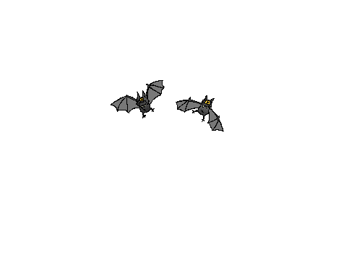
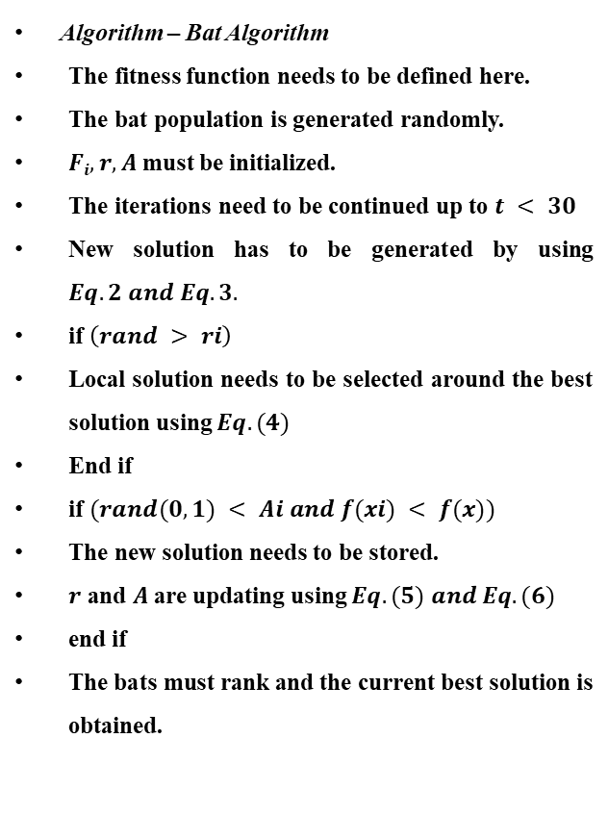
Bat Algorithm
Algorithm – Bat Algorithm
The fitness function needs to be defined here.
The bat population is generated randomly.
$Fi, r, A$ must be initialized.
The iterations need to be continued up to $t < 30$
New solution has to be generated by using $Eq. 2 and Eq. 3.$
if $\left(rand > ri\right)$
Local solution needs to be selected around the best solution using $Eq. (4)$
End if
if $(rand(0,1) < Ai and f(xi) < f(x))$
The new solution needs to be stored.
$r$ and $A$are updating using $Eq. (5) and Eq. (6)$
end if
The bats must rank and the current best solution is obtained.
The basic Bat algorithm is bio-inspired on the bio-sonar or echo location characteristics of bats.
In nature, bats release ultrasonic waves to the environment around it for the purposes of hunting or navigation.
After the emission of these waves, it receives the echoes of the waves, and based on the received echo they locate themselves and identify obstacles in their ways and preys.

Slide 18

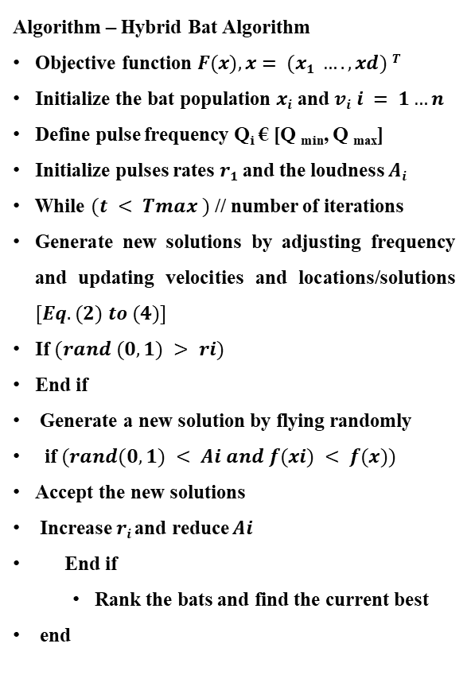
Hybrid Bat Algorithm
Algorithm – Hybrid Bat Algorithm
Objective function $F(x), x= (x1 …., xd) T$
Initialize the bat population $xi$ and $vi i = 1…n$
Define pulse frequency Q_{i} € [Q _{min}, Q _{max}]
Initialize pulses rates $r1$and the loudness $Ai$
While $(t < Tmax )$ // number of iterations
Generate new solutions by adjusting frequency and updating velocities and locations/solutions $[Eq. (2) to (4)]$
If $(rand (0,1) > ri)$
End if
Generate a new solution by flying randomly
if$(rand(0,1) < Ai and f(xi) < f(x))$
Accept the new solutions
Increase $ri$and reduce $Ai$
End if
Rank the bats and find the current best
end
Hybrid Bat Algorithm was obtained by hybridizing the original BA using the Differential Evolution (DE) strategies.
DE optimizes a problem by maintaining a population of candidate solutions and creates new candidate solutions by combining the existing ones according to its simple formulae, and then keeping whichever candidate solution has the best score or fitness on the optimization problem at hand. DE supports a differential mutation, a differential crossover and a differential selection.

Slide 19
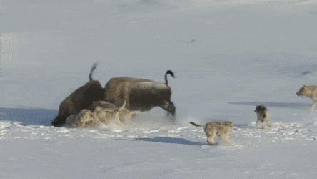
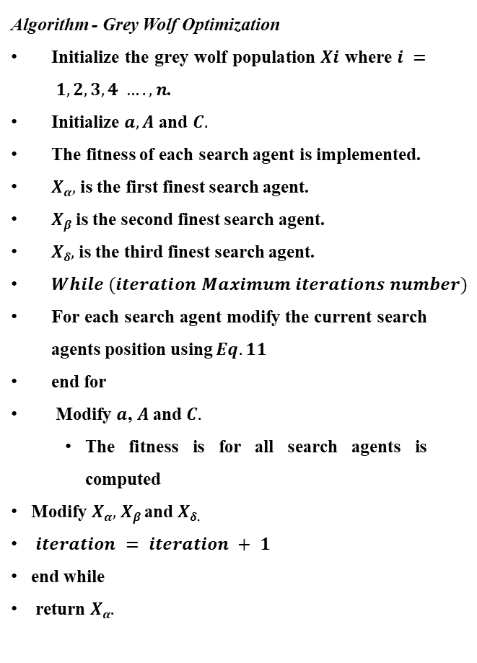
Grey Wolf Optimization Algorithm
Algorithm - Grey Wolf Optimization
Initialize the grey wolf population$Xi$ where $i = 1,2,3,4 …., n$.
Initialize $a, A$ and $C.$
The fitness of each search agent is implemented.
$Xα,$ is the first finest search agent.
$Xβ$is the second finest search agent.
$Xδ,$ is the third finest search agent.
$While (iteration Maximum iterations number)$
For each search agent modify the current search agents position using $Eq. 11$
end for
Modify $a$, $A$and $C.$
The fitness is for all search agents is computed
Modify $Xα,$ $Xβ$ and $Xδ$.
$iteration = iteration + 1$
end while
return $Xα.$
The GWO algorithm mimics the leadership hierarchy and hunting mechanism of gray wolves in nature.
Four types of grey wolves such as alpha, beta, delta, and omega are employed for simulating the leadership hierarchy.
In addition, three main steps of hunting, searching for prey, encircling prey, and attacking prey, are implemented to perform optimization.

Slide 20
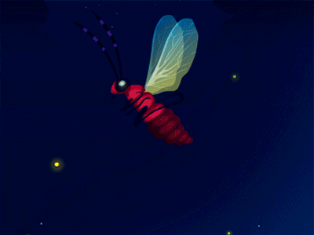
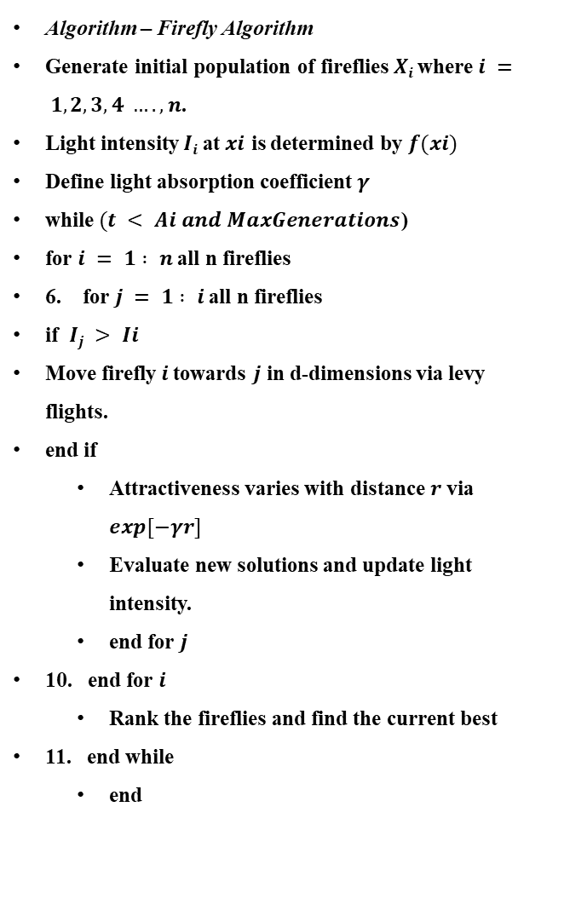
Firefly Algorithm
FA tries to mimic the flashing pattern and attraction behavior of fireflies.
The purpose of these flashing lights is two-fold: to attract mating partners and to warn potential predators.
Obviously, this flashing light and its intensity can obey some rules, including physical laws.
The attractiveness is proportional to the brightness and they both decrease as their distance increases for any two flashing fireflies, the less bright one will move towards the brighter one.
If there is no brighter one than a particular firefly, it will move randomly.
Algorithm – Firefly Algorithm
Generate initial population of fireflies $Xi$ where $i = 1,2,3,4 …., n$.
Light intensity $Ii$at$xi$ is determined by $f(xi)$
Define light absorption coefficient$γ$
while $(t < Ai and MaxGenerations$)
for $i = 1 : n$ all n fireflies
6. for $j = 1 : i$ all n fireflies
if $Ij > Ii$
Move firefly$i$towards $j$ in d-dimensions via levy flights.
end if
Attractiveness varies with distance $r$via $exp[−γr]$
Evaluate new solutions and update light intensity.
end for $j$
10. end for $i$
Rank the fireflies and find the current best
11. end while
end

Slide 21
Techniques
Classifiers
Performance Metrics
Base Model
Randomized Search CV
Bat Algorithm
Hybrid Bat Algorithm
Grey Wolf Optimization
Firefly Algorithm
Random Forest
Extra Tree
KNN
Gaussian NB
SVC
Decision Tree
Accuracy
Precision
Recall
F1-Score
Roauc
Log Loss
Confusion Matrix
Time Taken (sec)

Slide 22
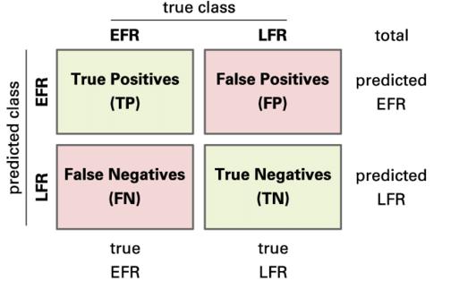
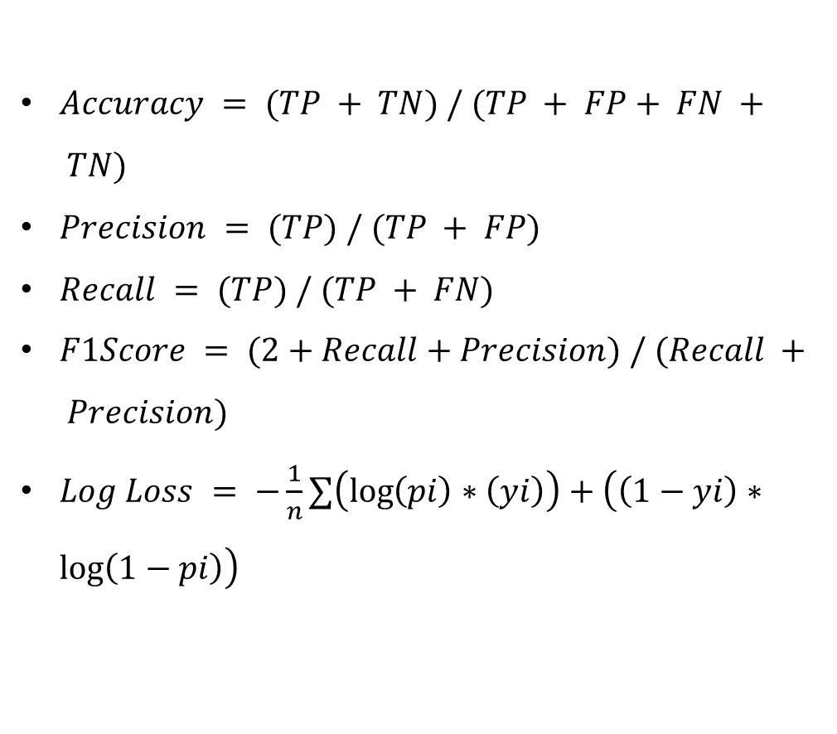
PERFORMANCES METRICS FORMULAE
$Accuracy = (TP + TN) / (TP + FP+ FN + TN)$
$Precision = (TP) / (TP + FP)$
$Recall = (TP) / (TP + FN)$
$F1Score = (2+Recall+Precision) / (Recall + Precision)$
$Log Loss = −\frac{1}{n}∑\left(\log\left(pi\right)∗\left(yi\right)\right)+\left(\left(1−yi\right)∗\log\left(1−pi\right)\right)$

Slide 23
EVALUATION RESULTS

Slide 30
REFERENCES
Chiu RWK, Chan KCA, Gao Y, et al. “Noninvasive prenatal diagnosis of fetal chromosomal aneuploidy by massively parallel genomic sequencing of DNA in maternal plasma”, Proc Natl Acad Sci U S A 105:20458–20463, 2008. https://doi.org/10.1073/pnas.0810641105
Harrington L, Alexander LT, Knapp S, Bayley H “Pim Kinase Inhibitors Evaluated with a Single-Molecule Engineered Nanopore Sensor”, Angew Chemie - Int Ed 54:8154–8159, 2015. https://doi.org/10.1002/anie.201503141
Shendure J, Balasubramanian S, Church GM, et al. “DNA sequencing at 40: Past, present and future”, Nature 550:345–353, 2017. https://doi.org/10.1038/nature24286.
Yang XS “A new metaheuristic Bat-inspired Algorithm. Stud Comput Intell 284:65–74, 2010. https://doi.org/10.1007/978-3-642-12538-6_6.
Krogh A “Two methods for improving performance of an HMM and their application for gene finding”, Proc Int Conf Intell Syst Mol Biol 5:179–186, 1997.
Aswath S, Kumar CMS, Reethi K, et al. “Enhancing the Performance of Classifiers in Detecting Abnormalities in Medical Data using Nature Inspired Optimization Techniques”, 2022 International Conference for Advancement in Technology (ICONAT). pp 1–7, 2022.

Slide 31
THANK YOU
The Presentation by
Chiranthan HV
Manoj S
Mary Priyanka
Tashmiya Banu

